Slide 1

DATA
SUFFICIENCY

Slide 2
Structure
Question
Data to solve
Options

Slide 3
Options
Data in the statement I alone is sufficient.
Data in the statement II alone is sufficient.
Data either in I or II alone are sufficient.
Data in both statement together are not sufficient.
Data in both statement together are needed

Slide 4
Tips
You don’t need to answer the question
Check whether the given data is sufficient or not.
Topics Involved
Quantitative Aptitude
Logical Reasoning

Slide 5
Rules
Analyze the given data. Don’t jump into it to solve
Represent the blood relation or coding-decoding problems on paper to easily process it.
Do not assume anything by your own knowledge. Make assumptions with the information provided in the given statements.
Practice venn diagrams as much as you can.

Slide 6

What is Geethu’s rank in the class? Statement I: There are 35 students in the class. Statement II: There are 7 students who have scored less than Geethu.
Example 1
Data in statement I alone are sufficient to answer the question.
Data in statement II alone are sufficient to answer the question.
Data either in I or II alone are sufficient to answer the question.
Data even in both the statement together are not sufficient to answer the question.
Data in both the statements together are needed.
Answer: E

Slide 7
What the distance from city A to city C? Statement I:City A is 90 kms from city B. Statement II: City B is 15 kms from city C .
Example 2
Data in statement I alone are sufficient to answer the question
Data in statement II alone are sufficient to answer the question
Data either in I or II alone are sufficient to answer the question
Data even in both the statement together are not sufficient to answer the question
Data in both the statements together are needed.
Answer: D

Slide 8
How is Beta related to Chitra? I. Alpha and Beta are brothers and Chitra and Drishti are sisters. II. Alpha’s son is Drishti’s brother.
Example 3
Data in statement I alone are sufficient to answer the question
Data in statement II alone are sufficient to answer the question
Data either in I or II alone are sufficient to answer the question
Data even in both the statement together are not sufficient to answer the question
Data in both the statements together are needed.
Answer: E

Slide 9
What is the mathematical code for ‘coconut’ in a certain code? I. The code for ‘give me coconut’ is ‘777’. II. The code for ‘you can bring coconut for me’ is written as ‘673196’.
Example 4
Data in statement I alone are sufficient to answer the question
Data in statement II alone are sufficient to answer the question
Data either in I or II alone are sufficient to answer the question
Data even in both the statement together are not sufficient to answer the question
Data in both the statements together are needed.
Answer: D

Slide 10
Out of the 100 animals in the Omaha zoo, how many are lions? I. 60 of 100 are newly born elephants (Calf). II. 20 animals out of 40 are not elephant but a lion.
Example 5
Data in statement I alone are sufficient to answer the question
Data in statement II alone are sufficient to answer the question
Data either in I or II alone are sufficient to answer the question
Data even in both the statement together are not sufficient to answer the question
Data in both the statements together are needed.
Answer: D

Slide 11
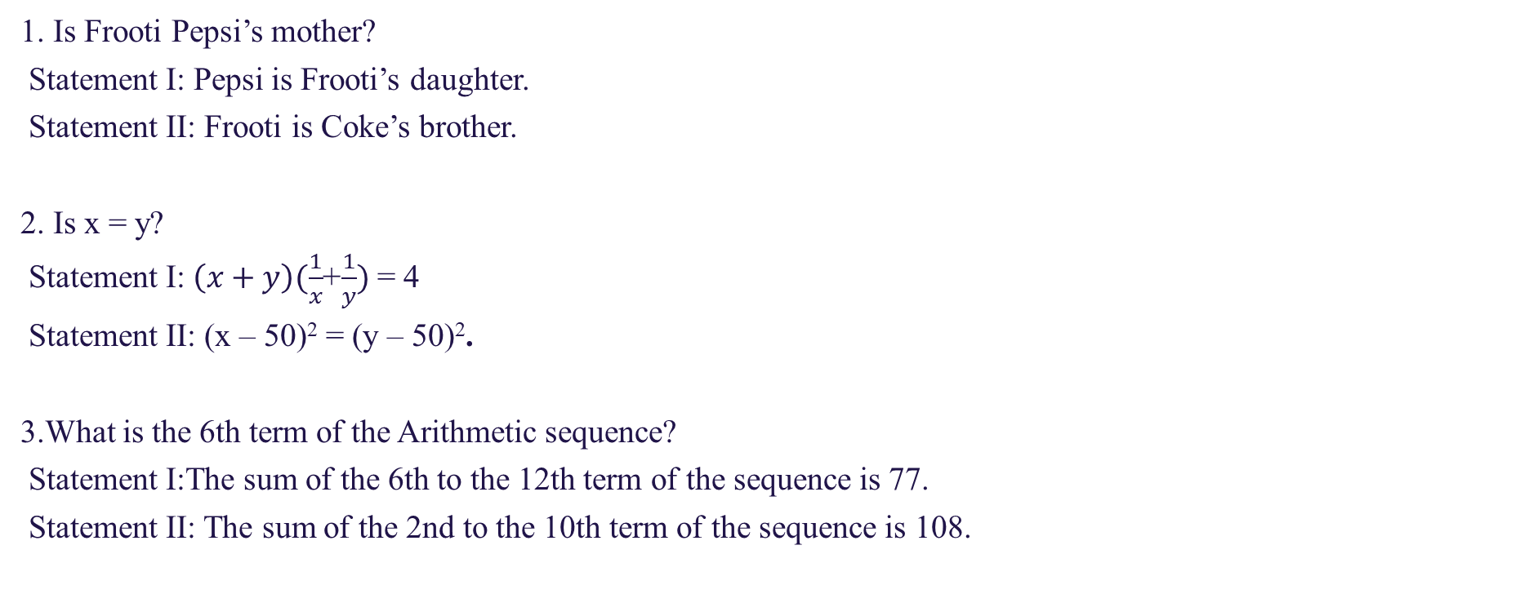
Assignment
1. Is Frooti Pepsi’s mother?
Statement I: Pepsi is Frooti’s daughter.
Statement II: Frooti is Coke’s brother.
2. Is x = y?
Statement I:$\left(x+y\right)(\frac{1}{x}$+$\frac{1}{y})$= 4
Statement II: (x – 50)² = (y – 50)².
3.What is the 6th term of the Arithmetic sequence?
Statement I:The sum of the 6th to the 12th term of the sequence is 77.
Statement II: The sum of the 2nd to the 10th term of the sequence is 108.

Slide 12
Assignment
4. When a positive integer 'x' is divided by a divisor 'd', the remainder is 24. d=?
Statement I: When 2x is divided by d, the remainder is 23.
Statement II: When 3x is divided by d, the remainder is 22.
5. Is x³ > x² ?
Statement I: x > 0
Statement II: x < 1
6. Find the distance travelled by Rajdhani express in two hours if it travels with its original speed?
Statement I: The train started from the origin station 20.25 hours later than the scheduled time towards its destination which is 750 km away from the origin.
Statement II: To reach the destination station in the scheduled time the loco – piolet of the train increases the speed of the train to 125% of the original speed.

Slide 13
Assignment
7. What is the marked price of an article?
Statement I: The selling price after giving 25% discount on the marked price is Rs. 600.
Statement II: If the article was sold on the marked price, then the profit earned on the cost price would be either 60% or Rs. 300.
8. What is the speed (in meters per hour) of motorboat in still water?
Statement I: The motorboat covers 100 km downstream in 10 hours.
Statement II: The motorboat covers 60 km in still water in 10 hours.
9. What is the area of a triangle ABC of base 12 cm?
Statement I: The height of the triangle is 8 cm.
Statement II: The triangle is an isosceles.

Slide 14

THANKYOU

